Slide 1
GPS II/MAPP
Meetings 1 – 10

Slide 2

Meeting 1
Welcome to GPS II/MAPP Program

Slide 3
License Rights to OCFS
Center for Development of Human Services, Institute for Community Health Promotion, SUNY Buffalo State acknowledges the State of New York’s and the Office of Children and Family Services’ royalty-free, non-exclusive and revocable license to reproduce, publish, distribute, or otherwise use any and all material herein for the limited purpose of training GPSII/MAPP Leaders and for as long as such materials and such training are deemed appropriate by NYS OCFS.
The Children’s Alliance of Kansas (CAOK) is the current national owner of the copyrighted “toolbox” of MAPP programs. NYS Office of Children and Family Services (NYS OCFS)/Center for Development of Human Services (CDHS) has permission from CAOK to provide MAPP programs (GPSII/MAPP, Caring For Our Own, Deciding Together, Shared Parenting, Mini-MAPP, and Child Sexual Abuse) to certify leaders through leader certification workshops and directly to foster/adoptive parents in New York State.
In order to better meet the needs of children and families in New York State, PS-MAPP was revised in 2004 and renamed GPSII/MAPP. Further revisions were made in 2005 after considering the feedback from MAPP Leaders throughout the state, and minor revisions and reformatting occurred in 2009. Significant revisions to the content and updating to reflect best practice and legal changes in New York State were made and approved by NYS OCFS in 2012 for this edition.
© 2009 Children’s Alliance of Kansas. Revised with permission NYS OCFS.

Slide 4
Matching Activity
  Find your match
  Introduce yourself
  (name, where you live, what brought you here)
  Introduce your match

Slide 5

12 Skills for Successful Fostering or Adopting
  Know your own family
  Communicate effectively
  Know the children
  Build strengths; meet needs
  Work in partnership
  Be loss and attachment experts

Slide 6
12 Skills for Successful Fostering or Adopting
  Manage behaviors
  Build connections
  Build self-esteem
  Assess health and safety
  Assess impact
  Make an informed decision

Slide 7

Successful Teams
  Name one achievement of your team
  Name one quality that made your team successful
  (3 minutes)
This Photo by Unknown Author is licensed under CC BY-SA-NC

Slide 8




Ways Information is Shared in the
GPSII/MAPP Program
  Participation in meetings
  Written materials
  Family consultations
  References

Slide 9
Important Definitions
  Safety
  Permanency
  Permanency Planning
  Well-being
  Foster Care
  Adoption
  Concurrent Planning

Slide 10
Children, Youth, and Parents Talk About Foster Care and Adoption
In order of appearance:
  Nicole, daughter of Peggy, currently in foster care
  Desiree, daughter of Peggy, currently in foster care
  Peggy, birth mother
  Dantavius, adopted son of Lynetta, brother of Moses

Slide 11
  Moses, adopted son of Lynetta, brother of Dantavius
  Lynetta, adoptive mother
  Angela, daughter of Denise, formerly in foster care
  Teddy, son of Denise, formerly in foster care
  Michelle, daughter of Denise, formerly in foster care
  Denise, birth mother

Slide 12
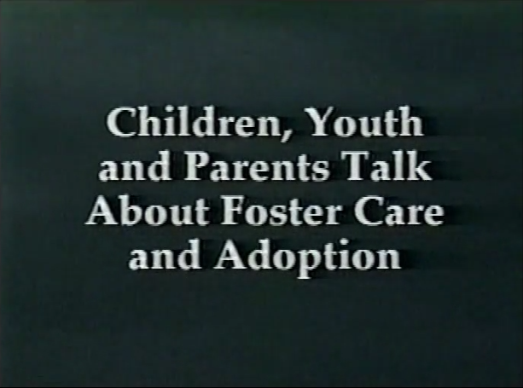
Video: Children, Youth and Parents Talk about Foster Care and Adoption (15 min)

Slide 13
Roadwork
  Read Meeting 1 handouts – bring questions to Meeting 2
  Talk about partnerships
  Complete your Family Profile. Call with any questions

Slide 14
Meeting 2
Where the MAPP Leads: A Foster Care and Adoption Experience

Slide 15
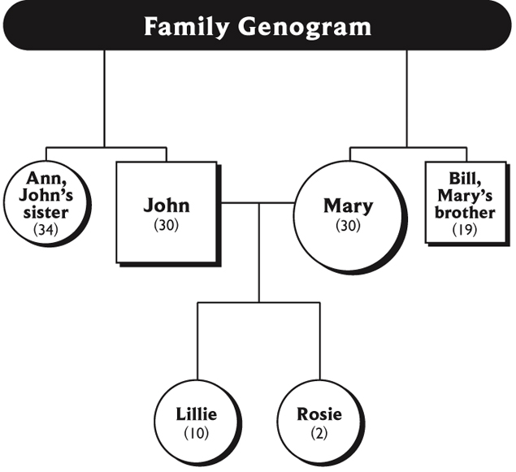
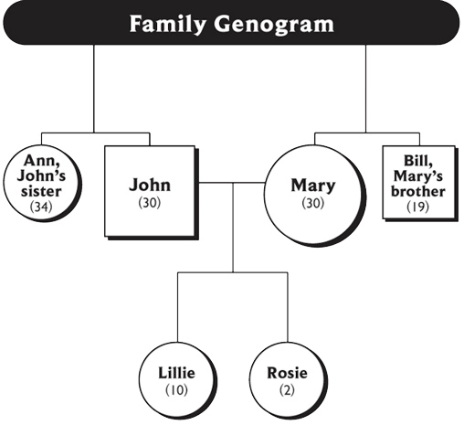

Slide 16
Erikson's Stages of Development*
Young Adulthood
Intimacy vs Isolation
Adolescence
Identity vs Diffusion
Ages 6 – Puberty
Industry vs Inferiority
Ages 3 – 5
Initiative vs Guilt
Ages 2 – 3
Autonomy vs Shame
Birth – Age 2
Trust vs Mistrust
* Erickson, E.H. Childhood and Society, 2d ed. NY: WW Norton, 1963.

Slide 17
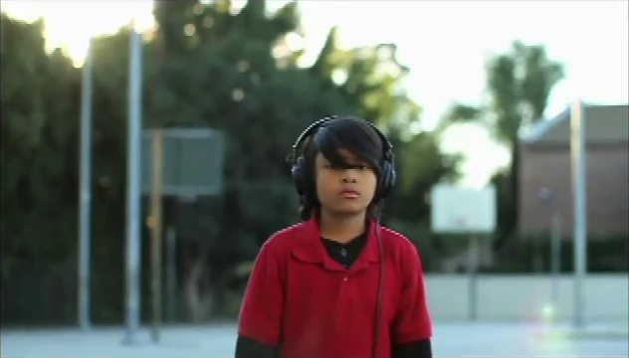
Video: The Children are Listening

Slide 18
Assessing Well-Being Needs of Children and Youth: Small Group Directions
  Select recorder/reporter
  Use case examples and worksheets to continue assessment
  After 8 to 10 minutes be ready to share assessment

Slide 19
Roadwork
  Complete Strengths/Needs Worksheet and Feedback to the Leader(s) – bring to Meeting 3
  Review Meeting 2 handouts
  Read Meeting 1, Handout 3
  Complete the Profile or schedule your Family Consultation

Slide 20
Meeting 3
Losses and Gains: The Need to Be a Loss Expert

Slide 21
Developmental Grieving
Developmental grieving is grieving experienced at milestones in a person's life. It could also be triggered by memories of previous losses.

Slide 22

Lifebook
A combination of story, diary, and scrapbook that has information about a child’s life experiences, including
  Pictures
  Report cards
  Souvenirs of special events
  Medical records

Slide 23
Understanding and Helping Children
Who Are Grieving
  Select a recorder and a reporter
  Write answers to questions on Handout 4 on the flipchart
  Be ready to report in 7 minutes

Slide 24
Helping Children with Healthy Grieving –
Family Strengths and Needs
  Find another family
  Use Handout 5
  Discuss your individual and family situational losses
  Discuss strengths and needs that these losses create for you in helping children who are grieving
  You have 10 minutes

Slide 25
What are important issues about loss and grieving that foster/adoptive parents need to consider before a child is placed with them?

Slide 26
What are important issues about loss and grieving that foster/adoptive parents need to consider after a child is placed with them?

Slide 27
Roadwork
  Review Meeting 3 handouts
  Bring questions to Meeting 4
  Complete Meeting 3, Handout 6, if appropriate
  Schedule your family consultation

Slide 28
Meeting 4
Helping Children with
Attachments

Slide 29

Video: Keema

Slide 30
The Basic Needs of Humans*
Making Dreams Come True
Self – Actualization
Self – esteem
Love and Belonging
Safety
Basic Survival
*Adapted from concepts developed by Abraham Maslow.

Slide 31
Definition of Attachment
Attachment is the affectionate and emotional tie between people that continues indefinitely over time and lasts even when people are geographically apart.*
* Fahlberg, Vera. “Attachment and Separation” PROJECT CRAFT, Training in the Adoption of Children with Special Needs. Ann Arbor, MI: University of Michigan School of Social Work, 1980, pp. V-1 - V-93.

Slide 32
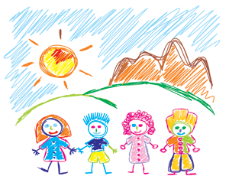
Why Attachment Is Important to Children
Attachment helps children:
  Develop a conscience
  (moral/spiritual development)
  Become independent
  (social development)
  Deal with stress, frustration,
  fear and worry
  (emotional development)

Slide 33
Why Attachment Is Important to Children (continued)
Attachment helps children:
  Think logically
  (mental development)
  Develop future relationships
  (social development)
  Grow physically and develop health
  (physical development)

Slide 34
Cycle of Need: Attachment
Need
Survival–Food
Expression
(Behavior)
Cry
Intervention
Feed Infant
Relaxation
Trust
Attachment
Secure

Slide 35
Cycle of Need: Mistrust
Need
Expression
(Cry)
Intervention
(Ignore, Slap)
Anxious
Angry
Fearful
Mistrust

Slide 36
Promoting, Building, Rebuilding and Supporting Attachments
  Select a group facilitator and a reporter
  Read your case example
  Answer the questions
  Be ready in 15 minutes

Slide 37
Roadwork
  Complete Strengths/Needs Worksheet and Feedback to the Leader(s) – bring to Meeting 5
  Review Meeting 4 handouts
  Be prepared to tell the group about 3 behaviors that “push your buttons”

Slide 38
Meeting 5
Helping Children and Youth Learn to Manage Their Behaviors

Slide 39
Carlos
  Carlos is five years old
  His mom is 23 years old, has two younger children, is a single parent with very little support
  When Carlos wants his mom’s attention and some physical affection, he “acts up” by having a temper tantrum

Slide 40
Carlos (continued)
  His mom gets upset with Carlos and hits him repeatedly while screaming at him
  Hitting continues until Carlos is bruised and sore
  Carlos’s mom feels guilty. She hugs and kisses Carlos, then takes him to store to buy him ice cream and candy

Slide 41
Cycle of Need
Need
Attention & Affection
Expression
(Behavior)
Tantrum
Hitting
Intervention
Hugs, kisses, ice cream & candy
Relaxation

Slide 42
Jilly
  Jilly is 11 years old
  Her mom is severely depressed. Spends most of her time lying in bed watching TV. She sleeps a lot and often lacks the energy to attend to her own personal care and hygiene
  She rarely pays any attention to Jilly

Slide 43
Jilly (continued)
  Jilly is angry and frustrated that her mother doesn’t pay attention to her
  She bites her mom
  Her mom gets out of bed, grabs Jilly, calls her names and slams her against the wall

Slide 44

Self-Concept
    Lovable
    Capable
    Worthwhile
    Responsible

Slide 45
Discipline Vs. Punishment
  Punishment is giving negative consequences for a behavior after it has occurred
  Discipline is teaching healthy behaviors

Slide 46
A behavior that pushes my button…
T
T
T
For a toddler:
For a school-age child:
For a teenager:
Tantrum
Tantrum
Tantrum
T
T
T
Hitting
Hitting
Hitting
T
T
T
Lying
Lying
Lying

Slide 47
Discipline Techniques to Help Children and Youth Manage Their Behaviors
  Be a Role Model
  Provide the Child with Time Out
  Provide Positive Reinforcers and Privileges
  Take Away Privileges
  Provide Natural & Logical Consequences

Slide 48
Discipline Techniques to Help Children and Youth Manage Their Behaviors
  Ignore the Behavior
  Ensure Restitution Occurs
  Hold Family Meetings
  Develop Behavioral Charts
  “Grandma’s Rule” or “This for That”
  Help the Child with Feelings

Slide 49
Discipline Techniques to Help Children and Youth Manage Their Behaviors
  Replace Negative Time with Positive Time
  Provide Alternatives for Destructive Acting-Out Behaviors
  Make a Plan for Change with a Child
  Make a Plan for Change with the Child and a Professional

Slide 50
Discipline Techniques to Help Children
and Youth Manage Their Behaviors
  Place each Post-It™ under a technique that might be effective with that behavior
  Be ready to share ideas

Slide 51
Choosing Effective Discipline Strategies
  Select a facilitator
  Select recorder/reporter
  Use handouts 5, 7, and 8 to analyze behaviors and plan interventions
  Describe how the strategies will provide for safety and teach a child to manage behavior
  Be prepared to report in 12 minutes

Slide 52
Reflection is:
  Focusing fully on the person
  Paying attention to the person's nonverbal behaviors and what he or she is saying at the moment
  Using this information to name the feeling

Slide 53
Reflection is:
  Expressing understanding of the feelings by using various phrases such as:
      You feel…
      You are…
      You seem…
      Sounds like…
      I get the feeling you…
      I hear you saying…

Slide 54
Reflection is not:
  Agreeing or disagreeing
  Reassuring (“Everything will be okay”)
  Telling the other person what to do and how to feel
  Giving advice or solving problems

Slide 55
False Allegations of Abuse in Foster and Adoptive Homes
  Naïve False Allegations – made when a child is confused or mixes fantasy with reality
  Manipulative False Allegations – made by a child, youth or adult in order to get desired behavior from foster or adoptive family or agency

Slide 56
Motives for a Child to Make a False Report
  to gain attention;
  to seek revenge or get even;
  to avoid consequences;
  to avoid a perceived threat;
  to resolve feelings of betrayal of birth family;
  to rescue birth family; or
  to get back home

Slide 57
Motives for Parents to Make a False Report
  distrust of foster parents;
  jealousy;
  avoid perceived threat to their child;
  misdirected anger;
  in a position of weakness/sadness;
  in grief and loss cycle; or
  to get their child back home

Slide 58
High Risk Situations for a False Allegation
  child is under a lot of stress;
  child is experiencing a lot of anxiety;
  upcoming court date with a possible decision for the child to return home;
  poor team relationship between the social worker, foster parent and birth family;
  infrequent home visits; and
  sight, sound, touch, smell, etc. that reminds
  the child of past abuse

Slide 59
Responding to Allegations
  Keep perspective
  Be Honest
  Cooperate
  Write Things Down
  Ask Questions
  Get Support

Slide 60
Roadwork
  Read Handouts 10, 12, 13, and 14
  Complete Handout 11, Strengths/Needs Worksheet for Meeting 5

Slide 61
Meeting 6
Helping Children with Birth
Family Connections

Slide 62

Identity and Culture
  Identity
  Self-concept
  Connections
  Culture

Slide 63
Indian Child Welfare Act (ICWA)
The Indian Child Welfare Act:
  Provides funds to tribes to operate child and family services programs;
  Gives tribes exclusive jurisdiction over any American Indian child who resides within the reservation;
  Gives tribal courts exclusive jurisdiction over any child who is a ward of the tribal court

Slide 64
Multiethnic Placement Act of 1994 (MEPA) and Amendment of 1996 (IEP)
  Decreases the time children wait to be adopted;
  Prohibits denial or placement delays (by any agency receiving federal funds) because of race, color, or national origin;
  Encourages transracial placements when appropriate same-race placements are not available;

Slide 65
Multiethnic Placement Act of 1994 (MEPA) and Amendment of 1996 (IEP) (continued)
  Prevents discrimination in child placement or in the choice of foster and adoptive homes, based on race, color, or national origin;
  Develops a diverse pool of foster and adoptive families

Slide 66
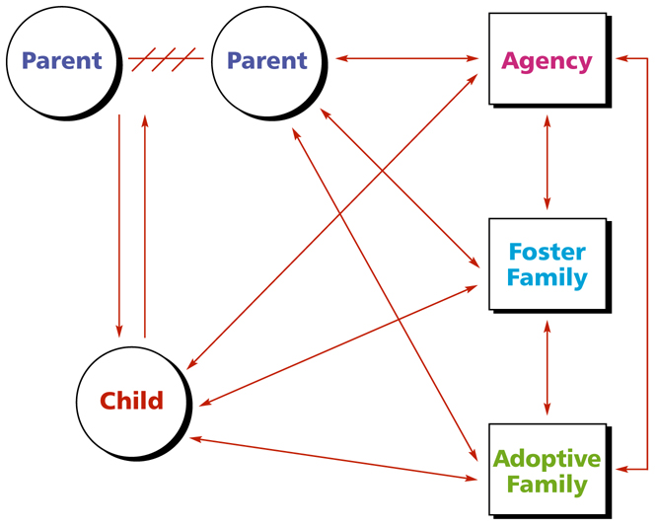
The Alliance Model of Child Welfare Practice*
*Adapted from Thomas D. Morton, “Partnerships in Parenting,” CWI.

Slide 67
Shared Parenting
Occurs when two or more adults have joint responsibility for care, nurturing, and decision making for the same child.

Slide 68
What are the benefits when parents
and foster parents share parenting?

Slide 69
What are the benefits to the foster parents when caring, nurturing, and decision making is shared with parents?

Slide 70
The Role of Foster Parents in Building Alliances with Parents of Children in Foster Care
  Recognize and support parent strengths
  Use strengths to engage parents
  Maintain confidentiality
  Manage personal emotions
  Share power and control
  Model parenting skills, mentor and/or teach
  parents

Slide 71
Directions for Shared Parenting Activity
Your team has 5 minutes to create as many ideas as possible for sharing parenting between visits.

Slide 72
Roadwork
    Complete the “Foster and Adoptive Parents’ Guide for Successful Visits or Contacts
    Write a letter to the parent of a child who may be placed in your home using Handout 10
    Read Handouts 4, 5, 6, and 7

Slide 73
Meeting 7
Gains and Losses:
Helping Children Leave Foster Care

Slide 74

Video: Angela

Slide 75
Helping Children Transition from Foster Care
    Select a reporter and a recorder
    Write one strategy–something the foster parent can say or do–for each message
    Be ready to share in 10 minutes

Slide 76
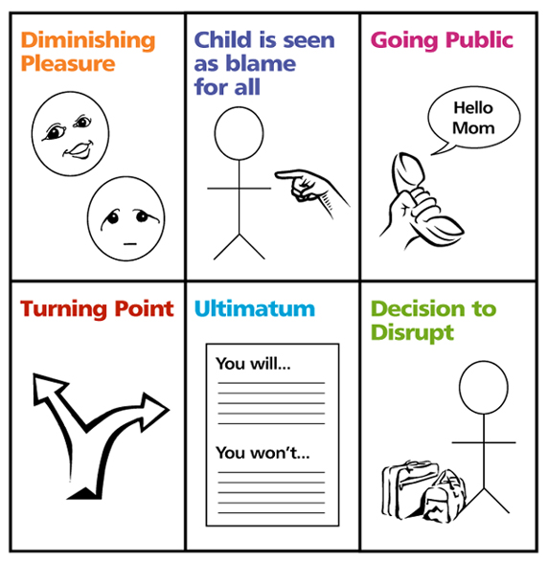
Stages of a Disruption or Dissolution

Slide 77
Planning to Prevent a Disruption
  Select a recorder/reporter
  Read the case examples
  Write preventions and interventions for each case example
  Be prepared to share in 5 minutes

Slide 78
Assessing Your Own Families
  Select a facilitator
  Each person shares at least two ideas
  For 3 minutes discuss:
      A stressful situation that could lead to a disruption in your home
      A strategy to intervene or prevent a possible disruption in your home

Slide 79

Giving Permission: The Steps of Integration

Slide 80
Commemoration
  An activity to honor important people in the child’s life
  A way of helping a child express grief
  Another way for important adults to demonstrate support and permission to love the people who are part of the child’s past, present, and future

Slide 81
Roadwork
  Complete your Strengths/ Needs Worksheet
  Read Handouts 12 through 17 and discuss them with friends and/or family members
  Complete Handout 18

Slide 82
Meeting 8
Understanding the Impact of Fostering or Adopting

Slide 83
Definition of System
A regularly interacting or interdependent group of items forming a unified whole.

Slide 84
Family as a System
  Family Boundaries
  Family Rules
  Family Roles
  Family Patterns of Decision Making
  Family Patterns of Communication

Slide 85
EcoMap
A tool to look at the balance between your family and the larger environment in which you live.

Slide 86
Creating an Eco-Map
  Solid for a strong relationship or energy flow _______
  Heavy solid for an especially strong relationship ____
  Dotted for a weak relationship ------
  Hash marks for a difficult relationship ///////////

Slide 87
Eco-Map Questions
  What are at least five additional “systems” you know would likely be added to your Eco Map with the addition of a child through foster care or adoption?
  For each of the above systems, which would be a source of energy and which would require energy?
  Which of your sources of energy might be negatively affected by your becoming a foster or adoptive family?
  Which of your sources of energy might remain strong should you become a foster or adoptive family?

Slide 88
Roadwork
    Review all the handouts
    Complete Handout 10, “Creating an EcoMap-Worksheet” and bring to Meeting 9
    Complete Handout 11, “First Day,” for the next family consultation

Slide 89
Roadwork
    Complete Handout 12, “Teamwork Roles of Foster and Adoptive Parents Worksheet,” and bring to Meeting 9

Slide 90
Meeting 9
Teamwork and Partnership in Foster Care and Adoption

Slide 91
Partnership Building and Teamwork in Foster Care
Teamwork – a process involving at least two people working with a coordinated plan to reach the same goal. Team members have different roles and responsibilities they can be relied upon to do.
R/R
R/R
R/R
Goal
R/R
R/R
R/R

Slide 92
Partnership Building and Teamwork in Foster Care (continued)
Partnership – a relationship between two or more parties, each contributing something of value in order to receive benefits. Contributions and benefits are defined by a social contract.
A
B
Social Contract

Slide 93
Key Concepts in Child Welfare
  Foster Care
  Adoption
  Child Protective Services
  Termination of Parental Rights (TPR)
  Physical Abuse
  Sexual Abuse
  Neglect
  Well-being
  Permanence
  Permanency Planning

Slide 94
Key Concepts in Child Welfare (continued)
  Concurrent Planning
  Safety
  Case Review
  Timeliness
  Reasonable Efforts
  Full Disclosure
  Searching for Relatives
  Case or Family Conferencing
  Permanency Hearing
  Confidentiality

Slide 95
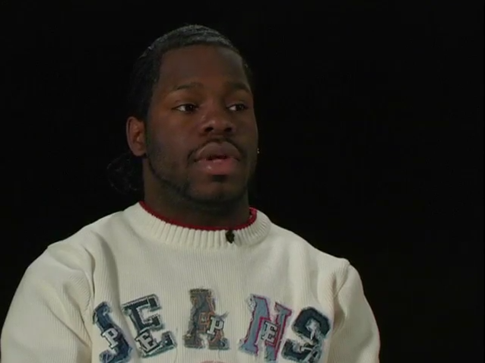
Video: Richard

Slide 96
Attachment vs. Commitment
Child’s Strengths and Needs
Informed
Adoption
Decision
Impact
Foster Family’s Strengths and Needs

Slide 97
Definition of Attachment
Attachment is the affectionate and emotional tie between people that continues indefinitely over time and lasts even when people are geographically apart.*
* Fahlberg, Vera. “Attachment and Separation” PROJECT CRAFT, Training in the Adoption of Children with Special Needs. Ann Arbor, MI: University of Michigan School of Social Work, 1980, pp. V-1 - V-93.

Slide 98
There are three main parts of communication:
  Verbal – what we say
  (I miss you.)
  Paraverbal – how we say it
  (I miss you. I MISS you. I miss YOU.)
  Nonverbal – what our bodies say

Slide 99
Communication
Verbal
(Words)
7%
Paraverbal
(Tone)
38%
Nonverbal
(Body)
55%

Slide 100
Roadwork
  Complete your final “Strengths/Needs Worksheet” and bring it to Meeting 10
  Read Handouts 7 and 10

Slide 101
Meeting 10
Endings and Beginnings

Slide 102
Instructions for Final Strengths/Needs Discussion
    Share your decision – to foster, to adopt, to foster/adopt, or to help children and families in another way
    Describe what helped you make your decision
    For those who have decided to be foster or adoptive parents, how have your ideas about the type of child who would fit into your family changed or remained the same?
    What do you see as your new strengths after participating in the GPSII/MAPP program?
    What do you see as your needs after participating in the GPSII/MAPP program?

